Slide 1
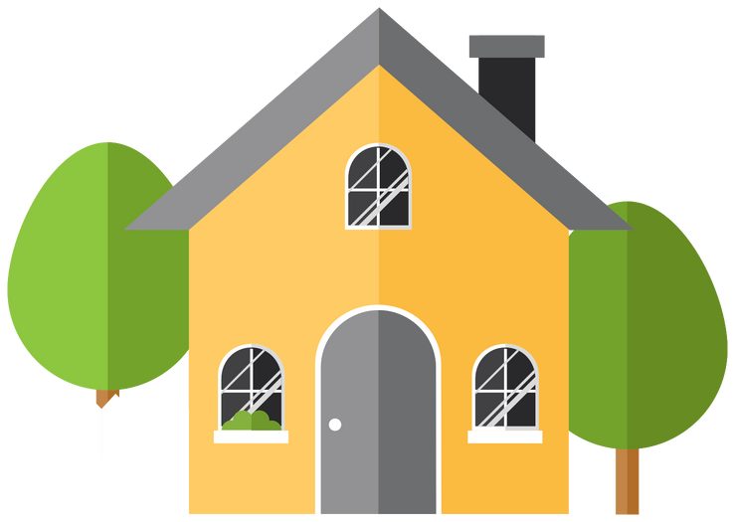

Factors Influencing the Residential House Prices in the United States
- P A MOHAMMED ARSHAD

Slide 2

Table of Contents
Major Factors Influencing the Residential House Prices in the United States
Micro factors influencing house prices
Median Home Price by State in the United States, 2022
The U.S. housing market: Facts and figures

Slide 3
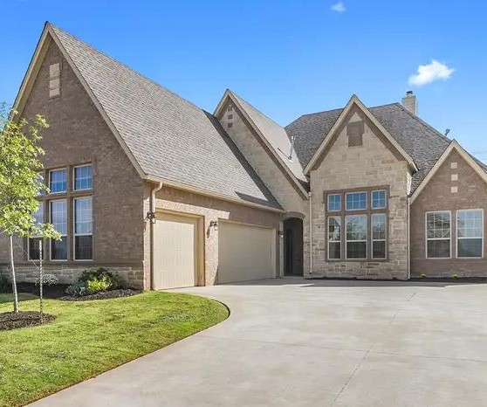
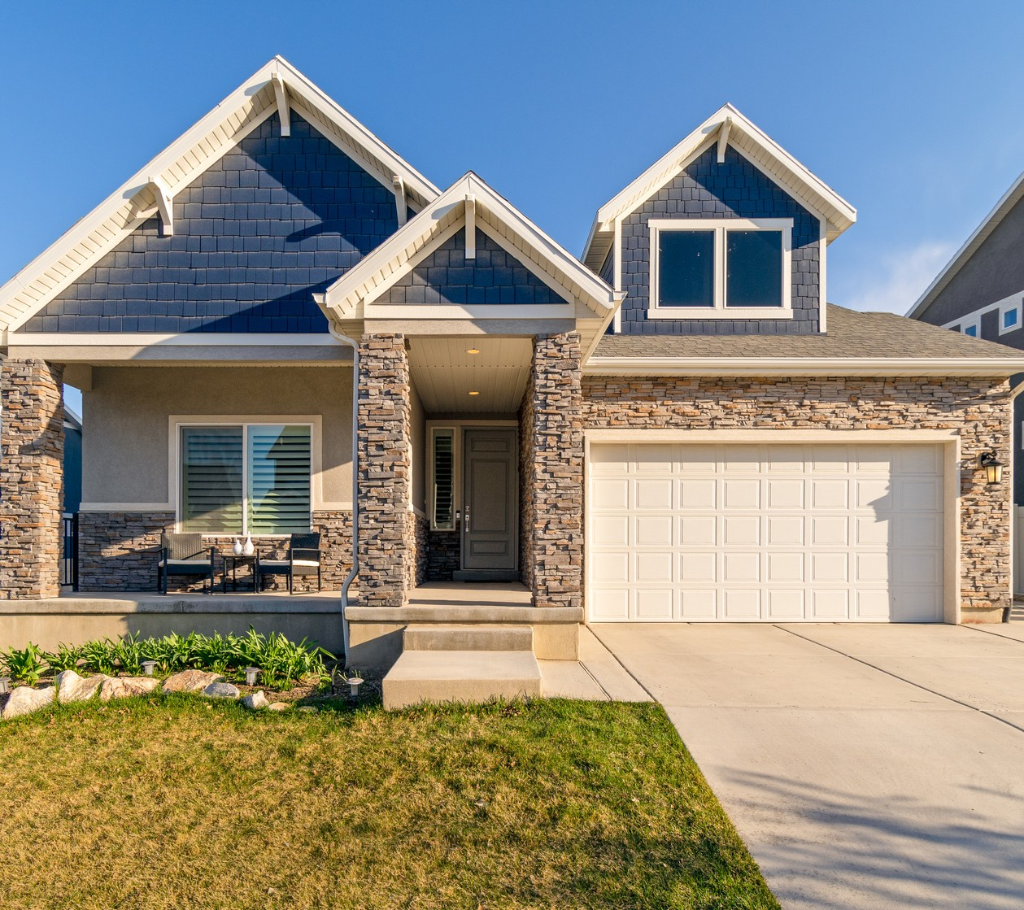
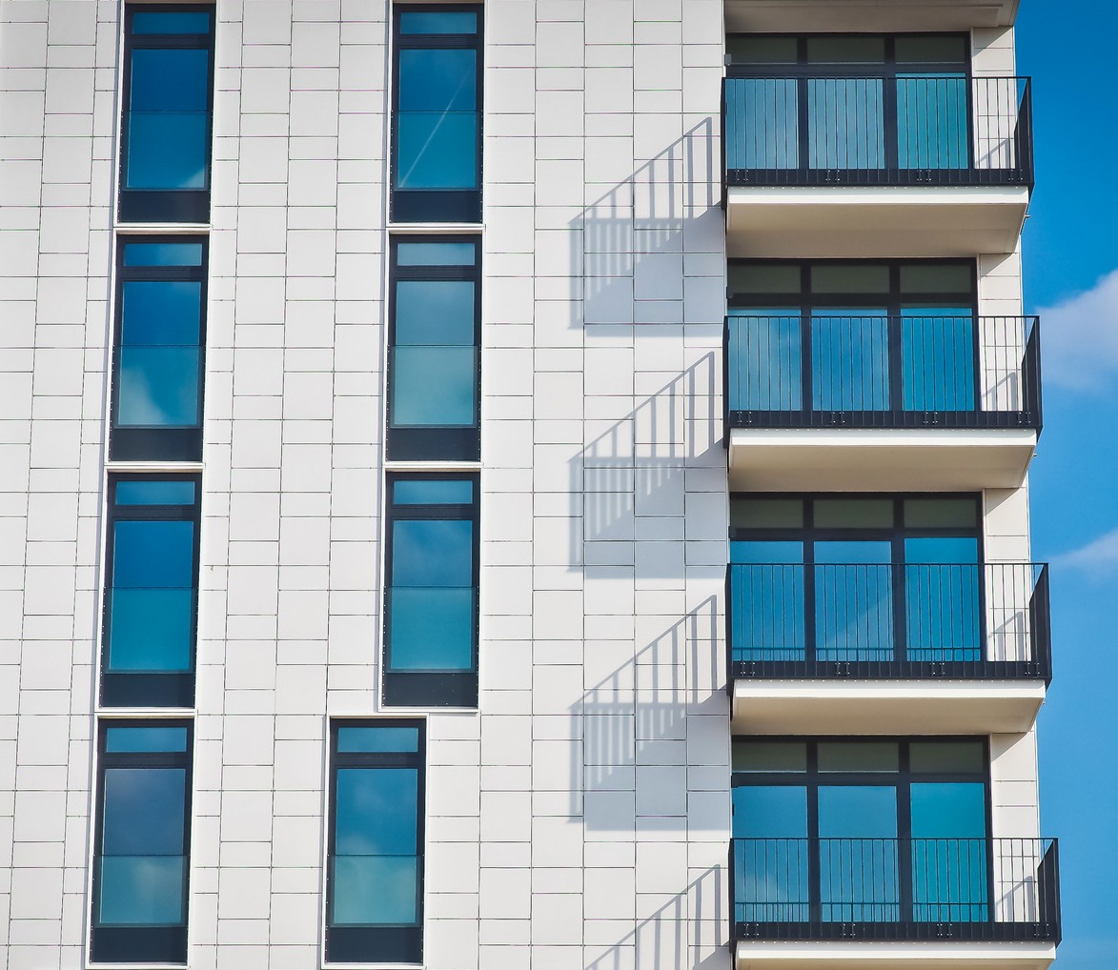
Major Factors Influencing the Residential House Prices in the United States

Slide 4

Economy
The Economy of a Country is a major factor affecting the Price of the House .
An economy encompasses all of the activities related to the production, consumption, and trade of goods and services in an entity.
This is generally measured by economic indicators such as the GDP, employment data, manufacturing activity, the prices of goods, etc.
As the Economy of a Country increases the House Price also Increases.
We can see a Strong Positive Correlation between the Economy and the Price of the House

Slide 5

Demographics
Demographics are the data that describes the composition of a population, such as age, race, gender, income, migration patterns, and population growth.
The United States had an official resident population of 331,893,745 on July 1, 2021, according to the U.S. Census Bureau and becomes the third largest populated country in the world.
Immigrants - There are a lot of immigrants in the united states. The government's new policy priorities designed to increase migrant protections and smooth immigrants arrival into the country helped a lot of immigrants to migrate to the United States.
Due to the increase in immigration to the United States, there is a greater demand than supply, which leads to an increase in property prices.

Slide 6

Interest Rates
The interest rate is the amount a lender charges a borrower and is a percentage of the principal - the amount loaned.
Interest rates also have a major impact on the real estate markets.
A mortgage loan is a secured loan that allows you to avail funds by providing an immovable asset, such as a house or commercial property, as collateral to the lender.
Changes in interest rates can greatly influence a person's ability to purchase a residential property.
Low interest rates tend to increase demand for property, driving up prices, while high interest rates generally do the opposite.

Slide 7
Government Policies/Subsidies
Legislation is also another factor that can have a sizable impact on property demand and prices.
Tax credits, deductions, and subsidies are some of the ways the government can temporarily boost demand for real estate for as long as they are in place.
In 2009, the U.S. government introduced a first-time homebuyer's tax credit to homeowners in an attempt to jump-start home sales in a sluggish economy. According to the Government Accountability Office, 2.3 Million people took advantage of the tax incentive and that was quite a sizable increase in the purchase of houses.
The US government is upcoming with new schemes such as Providing Incentives for Land Use and Zoning Reform and Reducing Regulatory Barriers for house owners to help them reduce the burden.

Slide 8

Area Desirability / Location
While housing prices tend to rise and fall on a national level we could see that prices in some parts of the country may increase, This occurs due to desirability.
If the Area consists of a lot of schools or a trendy area where people want to or desire to be may affect the price of the house in that area significantly
Say if a new manufacturing plant or large company brings jobs to the area, people may flock to the region, even if the populatis was small before.
If new housing isn't built fast enough to accommodate the influx of people, housing pries in the area will rise as by the Supply and Demand principle.

Slide 9
Home size and usable space
The size of the house and usable space are important factors that affect the price of the house.
The bigger the Area of the house and the surrounding the greater the price.
The more usable area around the house can be used for renovations and upgrades.
Livable space is what is most important to buyers and appraisers. Bedrooms and bathrooms are most highly valued, so the more beds and baths the home offers, the more the home is generally worth.
The added features such as a swimming pool , Garage, Attic also influence in increasing price of the house.

Slide 10
Age and condition
Houses that are newer appraise at a higher value .
This is because of the fact that critical parts of the house, like plumbing, electrical, the roof, and appliances are newer and therefore less likely to break down, can generate savings for a buyer.
Many buyers will pay top-dollar for a move-in-ready home. This is why most buyers require an inspection contingency in their contract — they want to negotiate repairs to avoid any major expenses following the sale.

Slide 11
The local market
Even if the house is in excellent condition, in the best location, with premium upgrades, the number of other properties for sale in that area and the number of buyers in the market can impact the house value.
If there are a lot of buyers competing for fewer homes it’s a seller’s market.
A market with few buyers but many homes on the market is referred to as a buyer’s market.
The market conditions can affect how long it takes for the house to sell. In a seller’s market, houses tend to sell quickly, whereas in a buyer’s market it’s typical for houses to see longer days on market (DOM).
If the house has been on the market for a longer period of time, buyers may perceive there is something wrong or that the price is too high.

Slide 12
Microfactors influencing house prices
Comparable sales
The closed sale price of houses recently sold in the neighborhood and they serve as the foundation for the unique comparative market analysis (CMA)
Products are only worth what consumers are willing to pay for them. That’s why comps focus on sold homes, not the prices set by the owner for the competition for their currently listed houses.
Sold prices tells exactly what buyers were recently willing to pay for other houses in the neighbourhood.

Slide 13
Presentation and pricing strategy
How much money one makes from their home sale often depends on how good the agent is at pricing and presentation.
Getting the price list wrong may make the home value slowly sink as it can rack up too many days on the market.
Poorly presented homes will sit on the market for months on end even if the price is right, resulting in the house price being lowered.
It is therefore necessary to advertise the house properly and make some renovations to reduce the Days on Market and increase the sale price.

Slide 14
Median Home Price by State in the United States, 2022
States with the Highest Median Home Price
1 ) Hawaii
Price: $848,926
Size: 1,309 sq. ft.
Cost per Square Foot: $649
The median price for a typical home in Hawaii is $848,926, more than twice the national average.
2) California Price: $760,800
Size: 1,625 sq. ft.
Cost per Square Foot: $468
3) District of Columbia Price: $701,895 Size: 1,440 sq. ft.
Cost per Square Foot: $487
4) Washington Price: $595,732 Size: 1,903 sq. ft.
Cost per Square Foot: $313
5) Colorado Price: $559,838
Size: 2,126 sq. ft.
Cost per Square Foot: $263

Slide 15
Median Home Price by State in 2022
States with the Lowest Median Home Price
West Virginia Price: $129,103 Size: 1,714 sq. ft.
Cost per Square Foot: $75
Mississippi Price: $157,828 Size: 1,879 sq. ft.
Cost per Square Foot: $84
Arkansas Price: $169,867
Size: 1,792 sq. ft.
Cost per Square Foot: $95

Slide 16
The U.S. housing market: Facts and figures
Americans spend more on housing than any other expense, with an average of 35% of income dedicated to housing costs.
Homeownership allows households to invest a portion of that money into a tangible asset that appreciates over time. For this reason, 91% of Americans indicate that they would like to own a home in their lifetime.
However, the costs of homeownership in the United States can be startling. According to Federal Reserve Economic Data, the median price of houses sold in 2022 is $428,700.
Home values increased 20% in the twelve months between April 2021 and May 2022.
Since the median household income in the United States is $67,521 a year. This means the median family can only afford a mortgage of around $250,000 and may find themselves being priced out of owning a home.
Costs & Homeownership by State
One way people are bringing down the cost of purchasing a home is by relocating. Location is the most significant contributor to housing costs

Slide 17
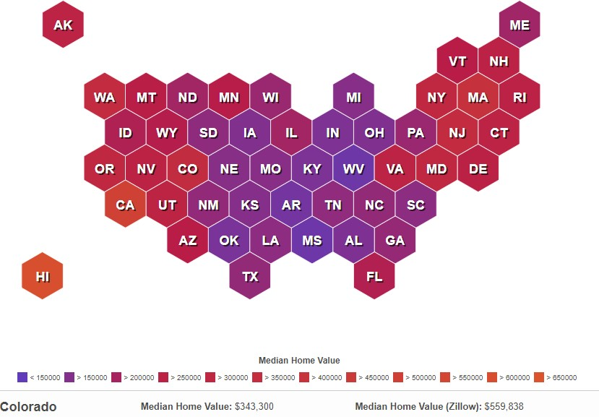
Median Home Price by State 2022
As we can see from the above graph, Home prices are highest in the Northeast and West, with the highest prices concentrated around the most densely populated areas.
Unsurprisingly, areas with higher housing prices tend to have lower homeownership rates. According to the latest census data, 65.4% of U.S. households own their home.
The District of Columbia has the lowest rate of homeownership, at 40.3%. California, New York, and Hawaii are among the states with the highest housing prices and the lowest levels of homeownership. On the other hand, states with relatively low housing costs tend to have higher levels of homeownership. West Virginia, which has the lowest typical-house cost, also has the highest homeownership rate, with 79.6% of residents owning their own home.

Slide 18
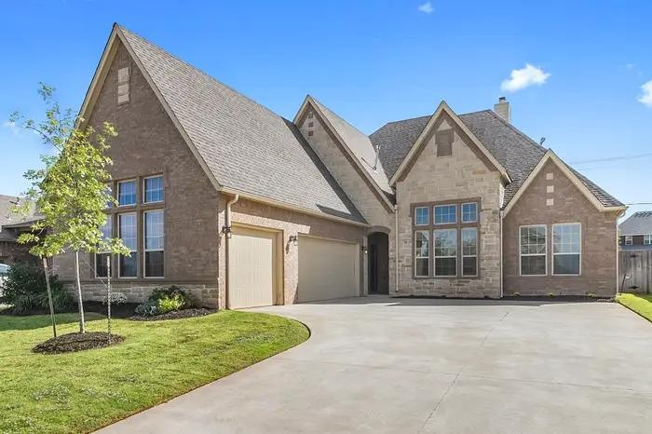
Thank You

